Slide 1
Git and Github
It’s not programming why should I care?

Slide 2


Git is a tool to manage versions of a project hence known as Version Control System.
Tracks and maintains a history of the changes.
Easy collaboration.
GitHub is a platform to host ‘Git’ repositories. It act as a remote storage.
Track issues
Deploy static web pages

Slide 3
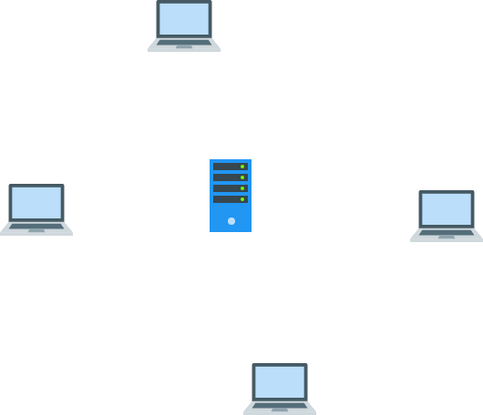
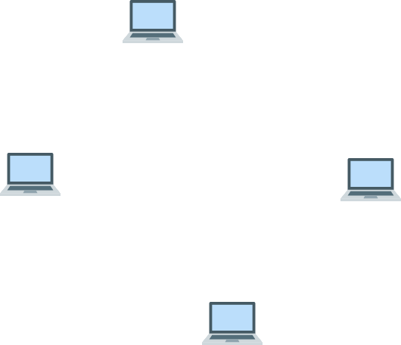
Version Control System & its types
Central
Distributed

Slide 4

Terminology

Slide 5
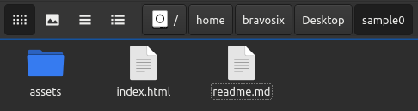
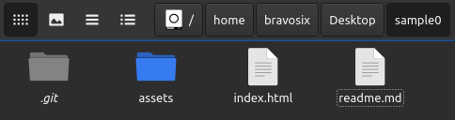
Repository aka repo
It is a special database which is essentially a folder but with better functionality.
Folder
Repository

Slide 6
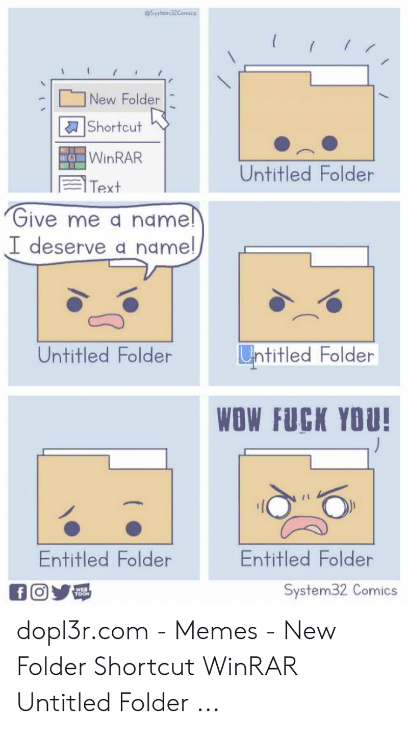
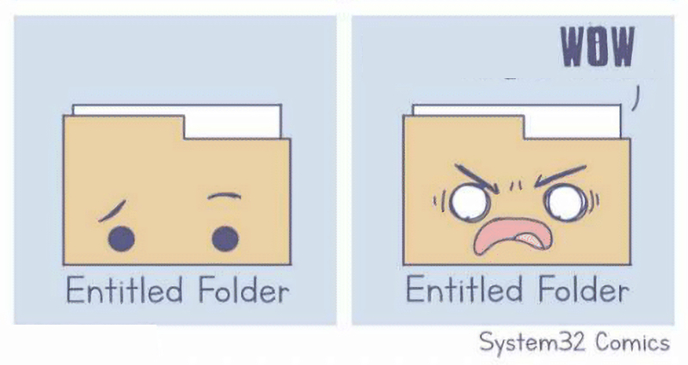
Working Directory
A folder where you actually work(code).

Slide 7
Staging Area
It contain the changes that will go in next commit.

Slide 8

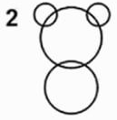
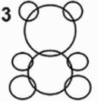

Commits
Snapshots of changes. We provide a message with each commit.
How To draw a panda?

Slide 9
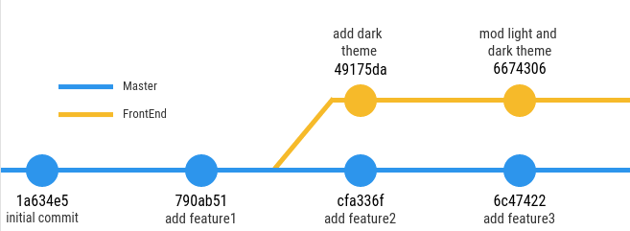
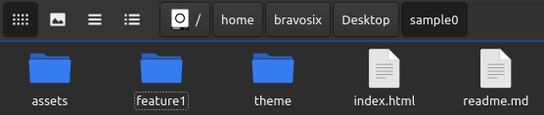
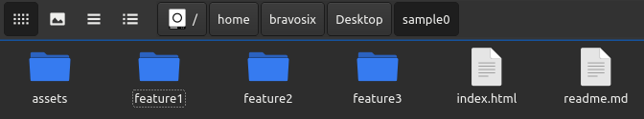
Branch
HEAD
Timeline of commits(changes).
FrontEnd
master

Slide 10



The Big Picture
Remote Repository
$ git push/pull origin master
Local Repository
9432a04
Initial commit
55adab0
mod files
$ git commit -m “mod files”
Working Directory
Staging Area
$ git add .
index.html
LICENSE
readme.md
index.html
readme.md

Slide 11



Clone and Fork a remote repository
Cloning means creating a local copy of a remote repository.
Forking means creating a remote copy for experimenting on github.
fork
https://github.com/utkarsh48/git-workshop-2021
https://github.com/tony-stark/git-workshop-2021
clone
clone

Slide 12

Practical

Slide 13
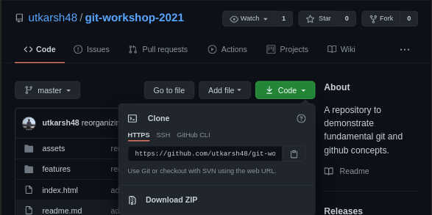
Step 0:
Initial Git configuration using
$ git config --global user.name “Your Name”
$ git config --global user.email “example@email.com”
Step 1:
Fork remote git repository from
https://github.com/utkarsh48/git-workshop-2021

Slide 14
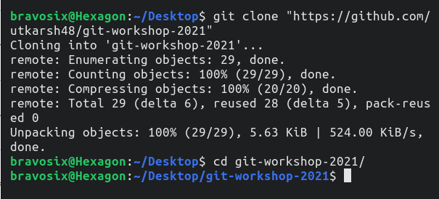
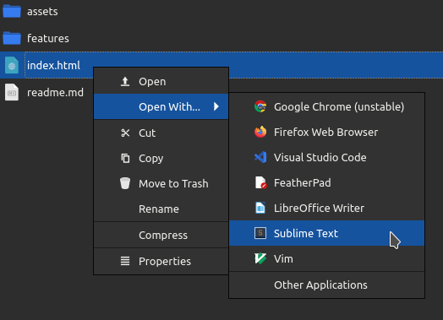
Step 2:
Clone git repository from
https://github.com/yourname/git-workshop-2021
Then change directory to cloned repo using ‘cd’ command.
Step 3:
Open ‘index.html’ in your favourite editor.
(You can use notepad)

Slide 15
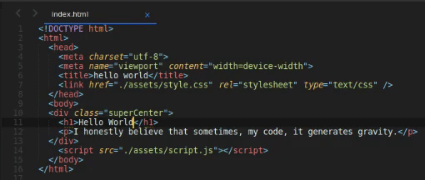
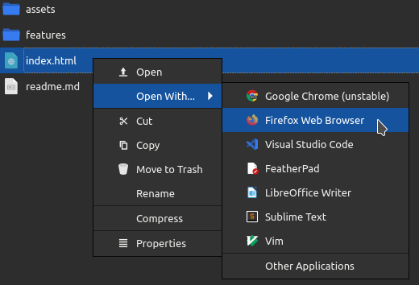
Step 4:
Replace ‘Hello World’ on line 11 with your name.
Save the file.
PS: You can view it in web browser.

Slide 16
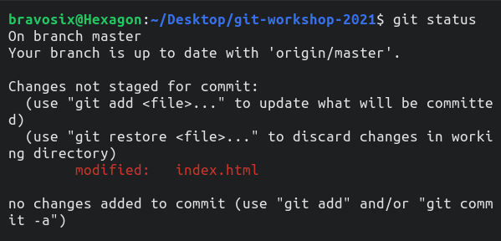
Step 5:
Checking status using
$ git status
Red color indicates unstaged changes
Step 6:
Staging changes using
$ git add .

Slide 17
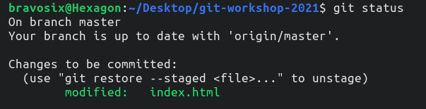
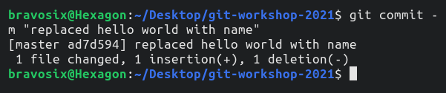
Step 7:
Checking status again using
$ git status
Green color indicates staged changes
Step 8:
Committing changes using
$ git commit -m “replaced hello world with name”

Slide 18
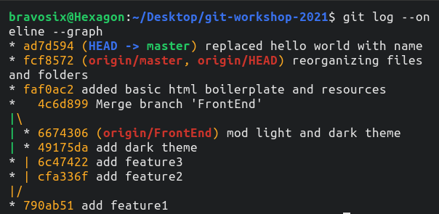

Step 9:
Verifying changes using
$ git log
PS: press ‘q’ to quit.
Step 10:
Pushing changes using
$ git push origin master
Authenticate with github credentials

Slide 19
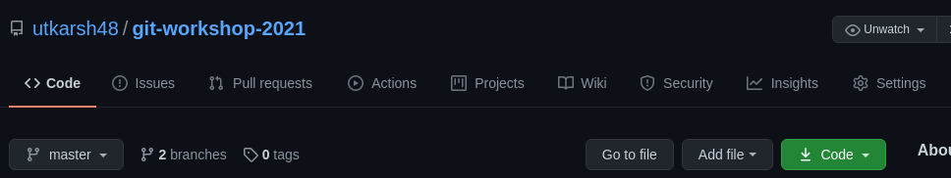
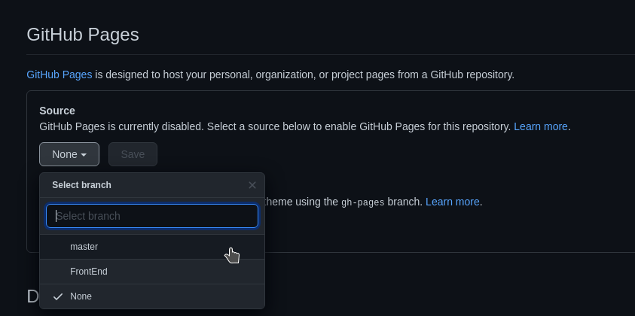
Hosting static web page
Make sure you have file named
‘Index.html’ in root directory.
Open repository settings
Scroll down to ‘Github Pages’
Change source to
‘master’ branch
Save
Page will reload scroll back to ‘Github Pages’ you will see your URL like
https://username.github.io/repo-name

Slide 20
Takeaway

Slide 21

Contact Us
Ashwani kumar
https://07akumar.tech
Utkarsh Dhiman
https://utkarshdhiman.xyz

